Slide 1

Scalable Databases – Final Project Phase 2
GROUP 3
SHIVAM
AMEY
SURAJ
RANJITH
THAO

Slide 2
TABLES OF CONTENT:
Data Sampling in Hive
Data Preparation in Python
Model Implementation
Model Evaluations
Target Predictions
Conclusion

Slide 3
DATA SAMPLING IN HIVE
Create new sample table
Add “Delayed” column
Extract 30,000 rows into a new table with random sampling
Save to local machine as a .csv file

Slide 4
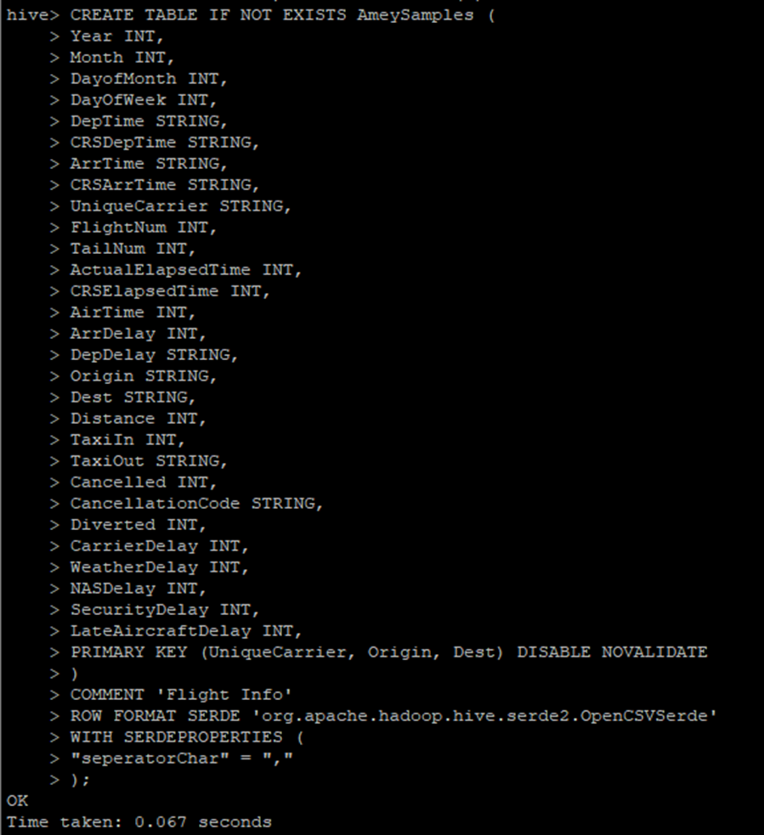
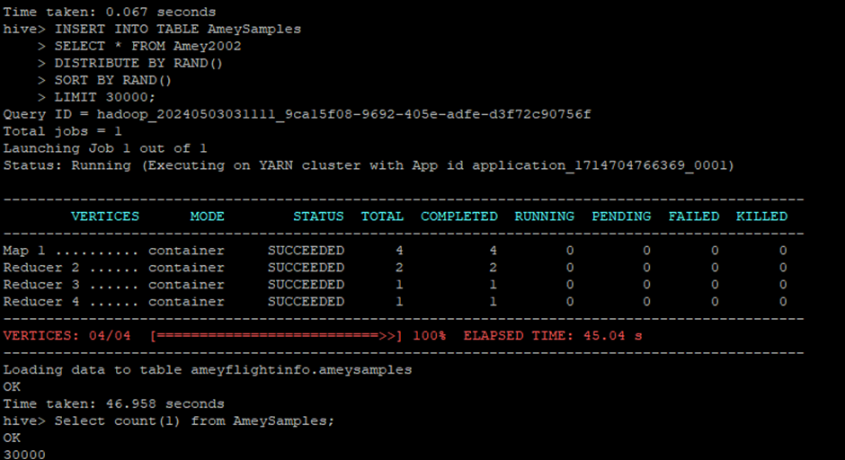
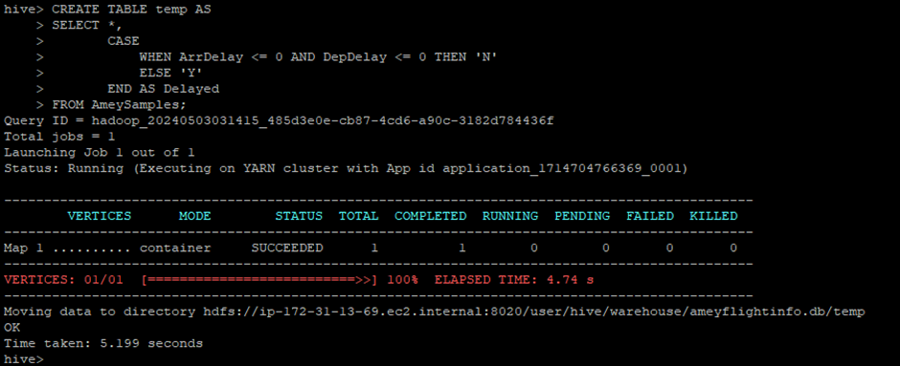

Slide 5
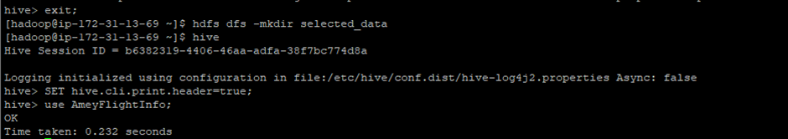
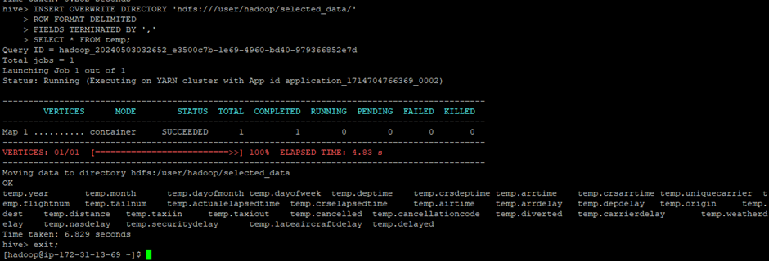

Slide 6
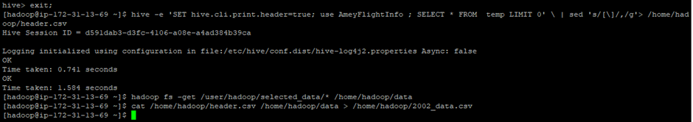
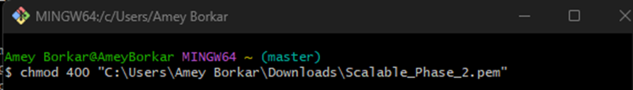
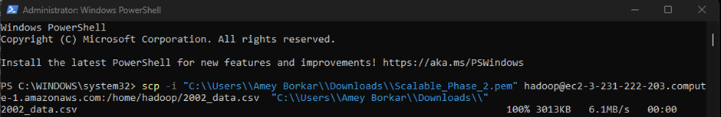

Slide 7
DATA PREPARATION IN PYTHON
Combining sample data from all years
Finding the null value columns from the merged data
Dropping column with more null value
Transformations:
4.1 Numerical columns are replaced with Median of the null value columns
4.2 Categorical data are replaced with the Mode data of the column
4.3 Encode Categorical values with LabelEncoder
Split the data (Train, Validate, Test)

Slide 8
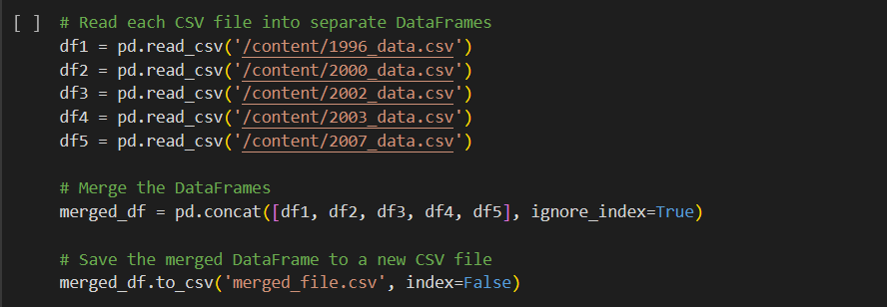
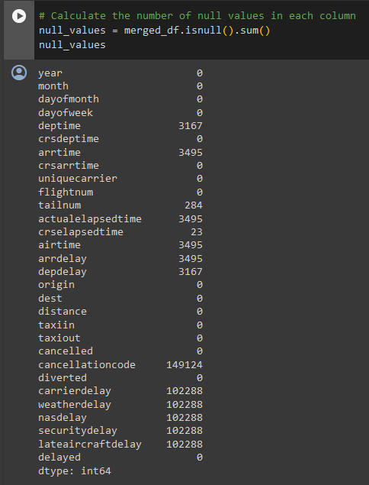
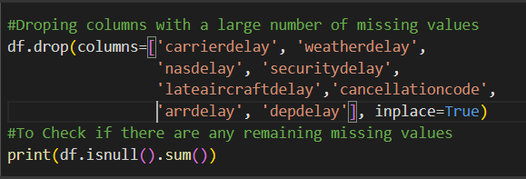

Slide 9
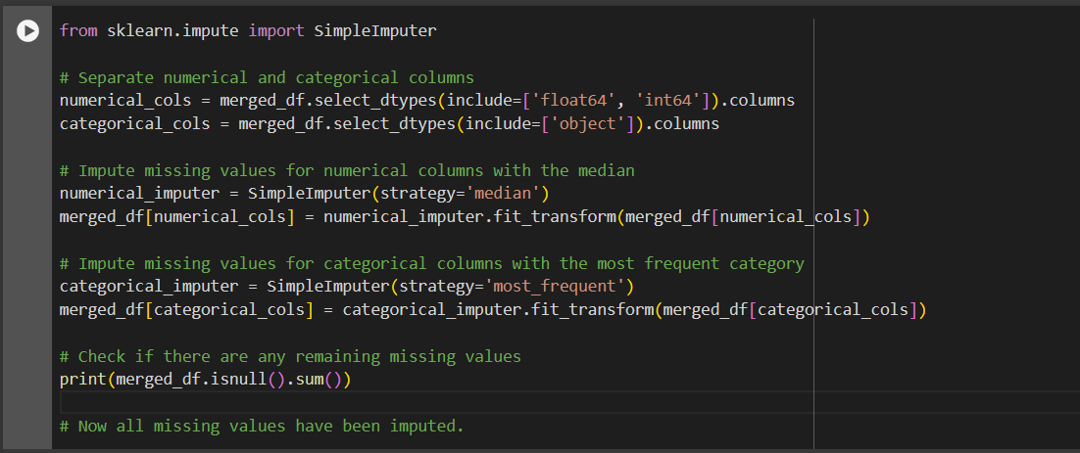

Slide 10
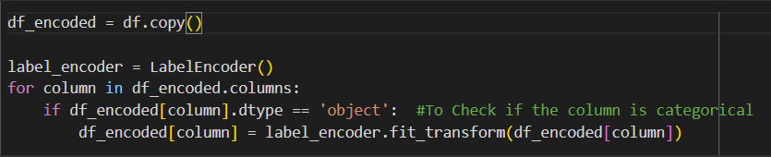
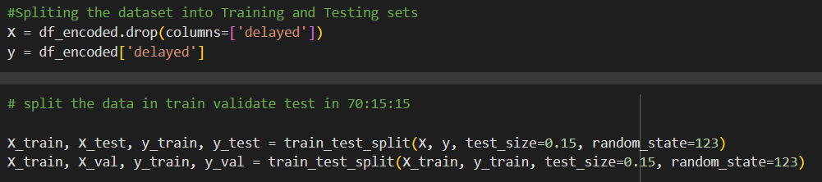

Slide 11
MODEL IMPLEMENTATION
XGBoost
Gradient Boosting
Decision Trees
Random Forest
Logistic Regression

Slide 12
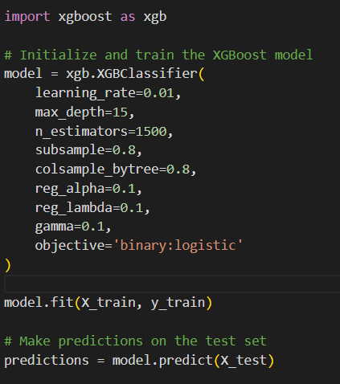
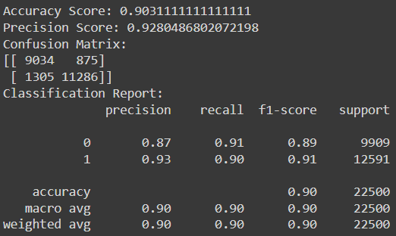
XGBOOST

Slide 13
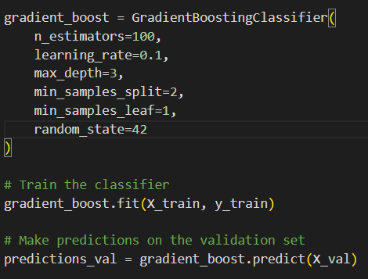
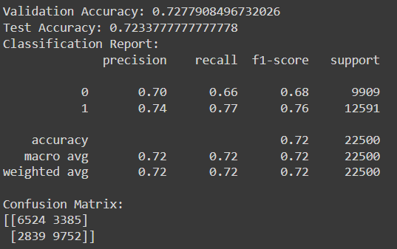
Gradient Boosting:

Slide 14
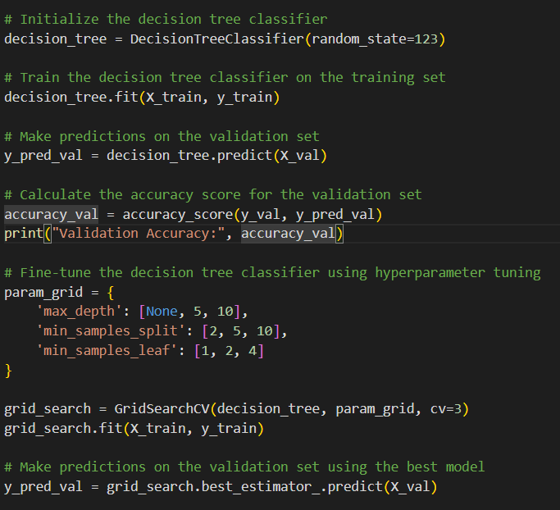
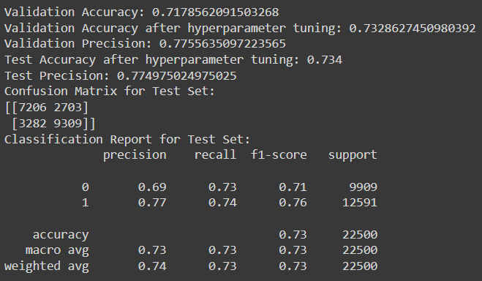
Decision Tree:

Slide 15
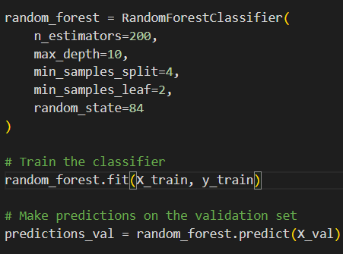
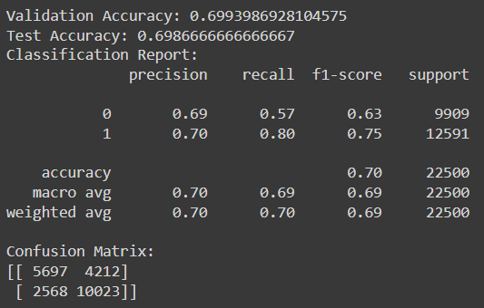
Random Forest

Slide 16
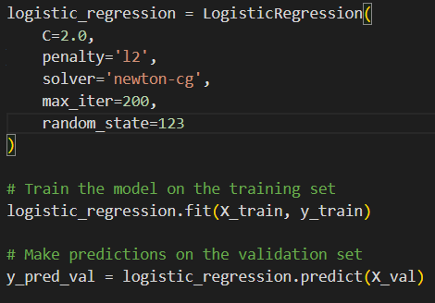
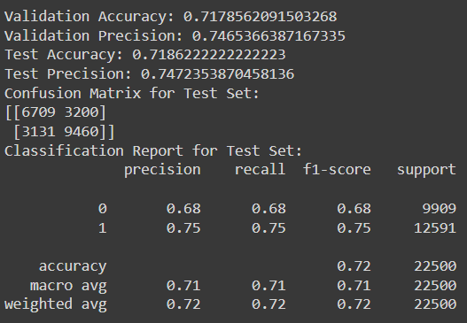
Logistic Regression

Slide 17
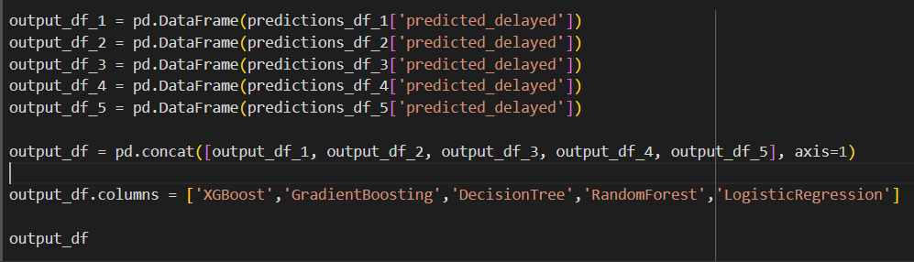
TARGET PREDICTIONS

Slide 18
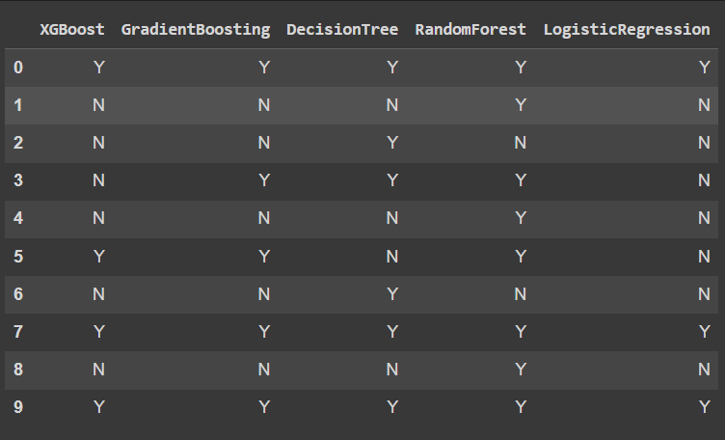
TARGET PREDICTIONS

Slide 19
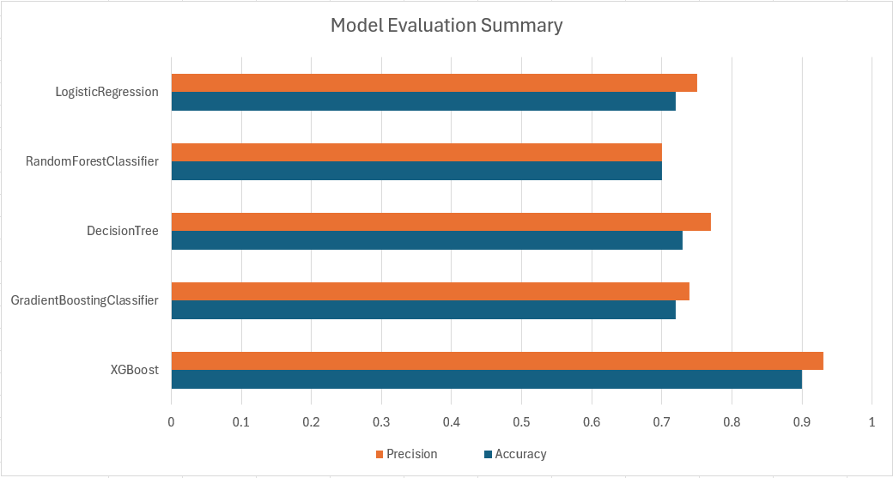
MODEL EVALUATIONS

Slide 20
CONCLUSION:
XGBoost performs the best out of the 5 models
~90% accuracy on test dataset
Model is predicting accurate values based on given features.

Slide 21
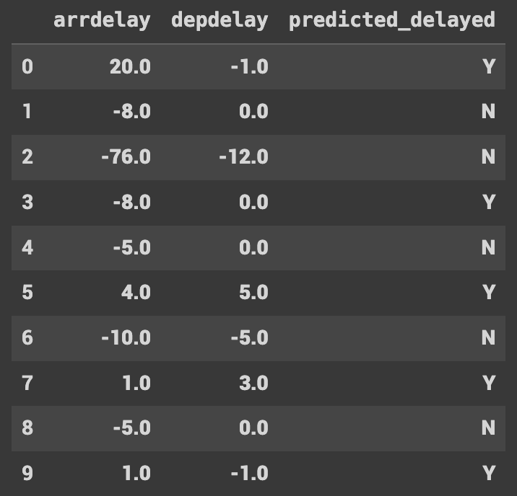
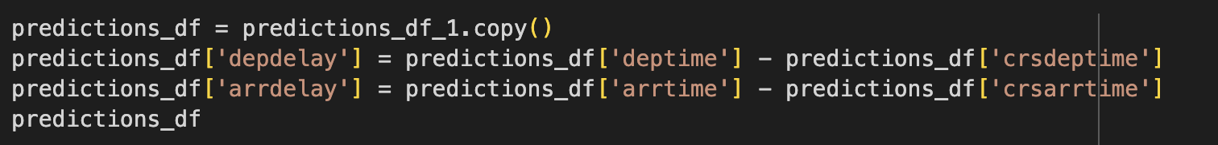
Extra step to check model results
Create depdelay and arrdelay column using arrtime vs. crsarrtime and deptime vs. crsdeptime
Extra Credits?

Slide 22
THANK YOU

